Slide 1
Victory Lap &
TA-led Activities
E-Portfolio Presentation Guidelines and Tips, CSE 390B Reflection and Victory Lap, TA Panel, Jeopardy Game

Slide 2
Lecture Outline
E-Portfolio Presentation Guidelines and Tips
CSE 390B Reflection and Victory Lap
  Metacognitive Skills
  Nand2Tetris Projects
CSE 390B TA Panel
  Class Recommendations, Extracurriculars, etc.
CSE 390B Jeopardy Game
  UW History, CSE 390B Course Staff, Seattle, Pop Culture

Slide 3
E-Portfolio Presentation Tips
Think about who your audience is
  Consider what your audience knows and doesn’t know
Ensure your E-Portfolio includes all the relevant information and reflection
  That is, your presentation should supplement your E-Portfolio
Avoid being verbose (keep presentation points concise)
  Ensure your presentation is easy to understand
Utilize and organize visuals from Tuesday
  Provide different ways to engage your audience

Slide 4
E-Portfolio Presentation Tips
Practice your E-Portfolio presentation
  Rehearse with a peer or with a TA
  Time yourself to ensure length of your presentation is appropriate
Do your best to speak slowly and project your voice
  Helps audience members further away or who are hard of hearing
Aim to maintain eye contact with the audience
  Helps slow down speech and makes you sound more authoritative
Engage the audience with hand motions, questions, and your energy or enthusiasm

Slide 5
Lecture Outline
E-Portfolio Presentation Guidelines and Tips
CSE 390B Reflection and Victory Lap
  Metacognitive Skills
  Nand2Tetris Projects
CSE 390B TA Panel
  Class Recommendations, Extracurriculars, etc.
CSE 390B Jeopardy Game
  UW History, CSE 390B Course Staff, Seattle, Pop Culture

Slide 6
Remember this?
The UW Student Experience
Math
Metacognitive
Skills
CSE
Nand2Tetris
Projects
Sociology
CSE 390B

Slide 7
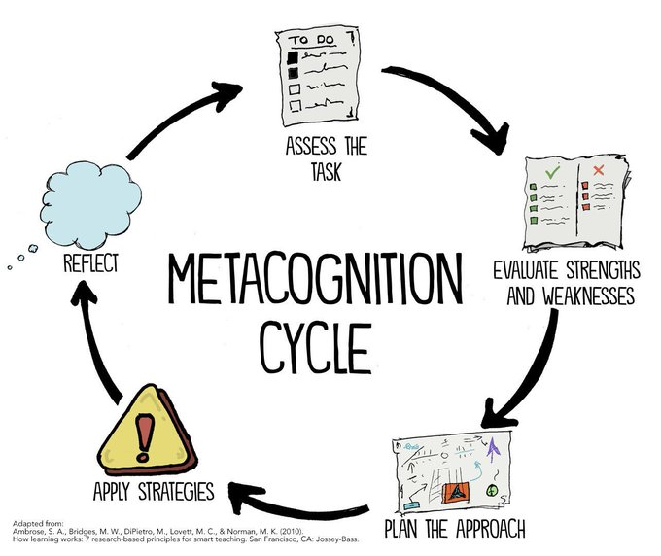
Metacognitive Skills Victory Lap!
Time Management
Note-Taking
Annotation
Exam Preparation
Test-Taking
Post-exam Reflection
Debugging
Working with Instructors & TAs
Reflection on Metacognition

Slide 8
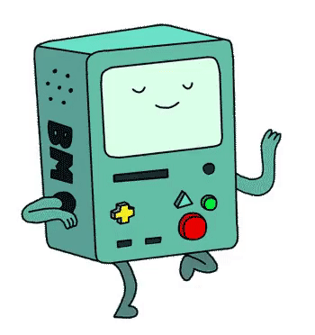
Nand2Tetris Projects
By building a computer, you’ve accomplished something that very few others have done!
  Many software writers consider building the computer as Somebody Else’s Problem™
  But so many technical skills and CSE courses tie into this task
  And even if you only write Java for the rest of time…
    Understanding the “layer below” makes you a better engineer in the “layer above”!

Slide 9
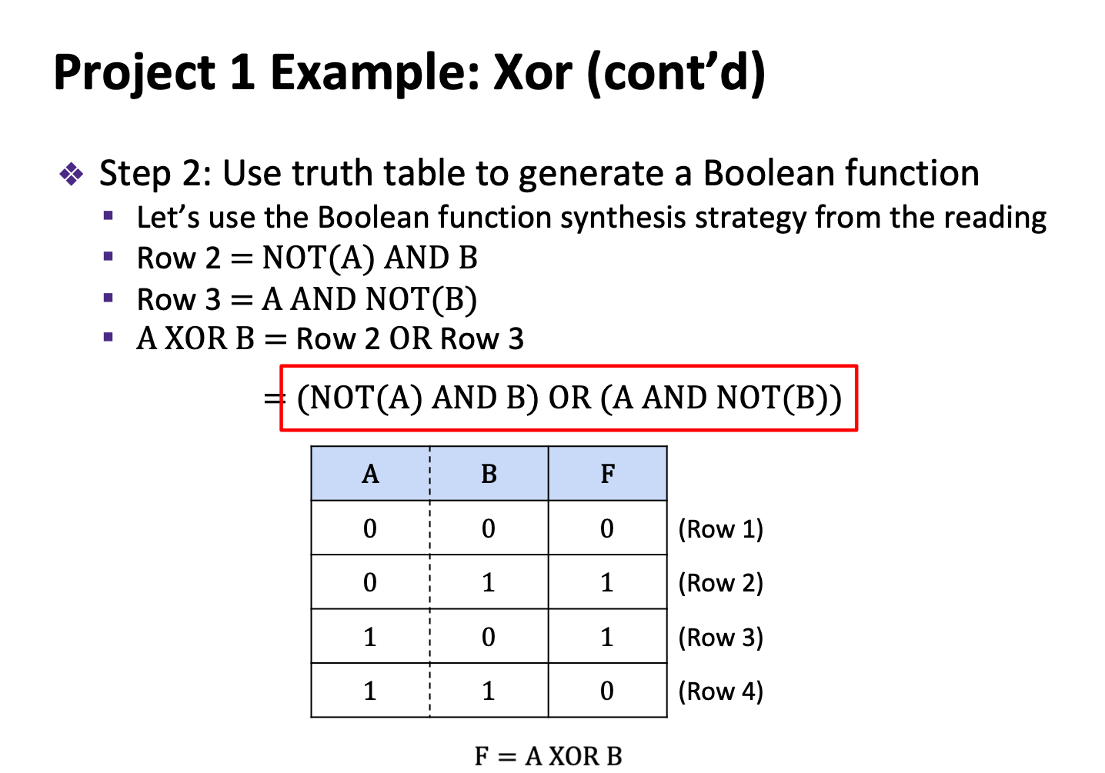
Boolean function synthesis
Practice with HDL—an unfamiliar, declarative style of programming
Project 2
Basic Logic Gates
NAND

Slide 10
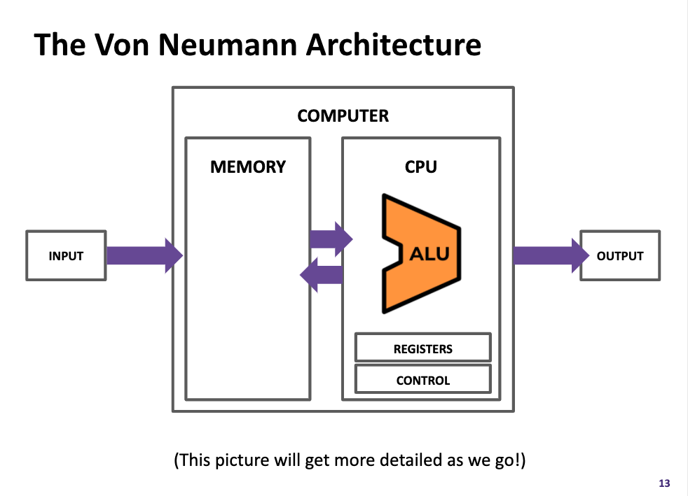
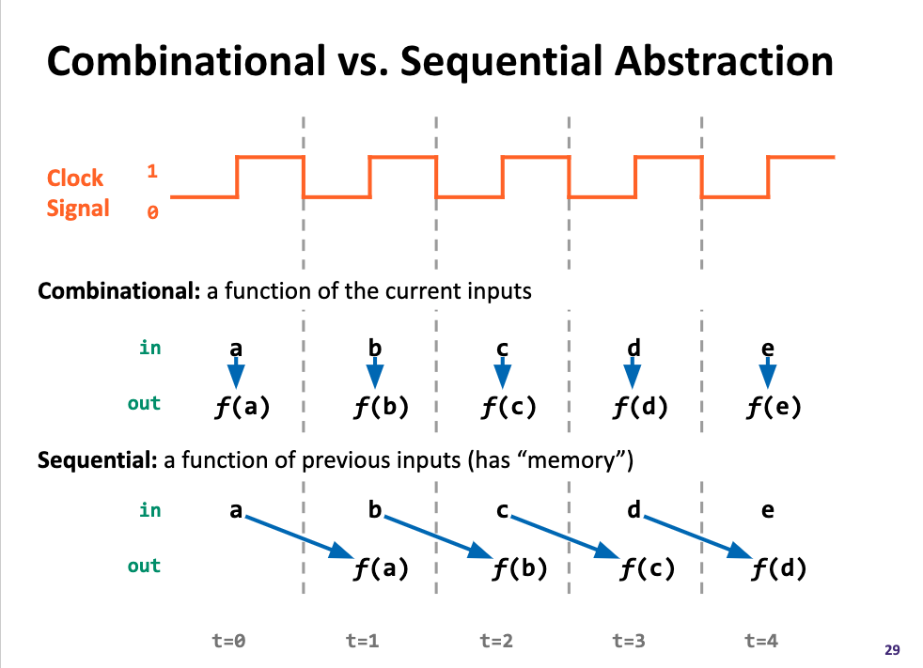
Components found in “real-world” computers: ALU, PC, Memory...
Learning a mental model for sequential logic
Project 4
Memory
Project 3
ALU
PC
Basic Logic Gates
NAND

Slide 11
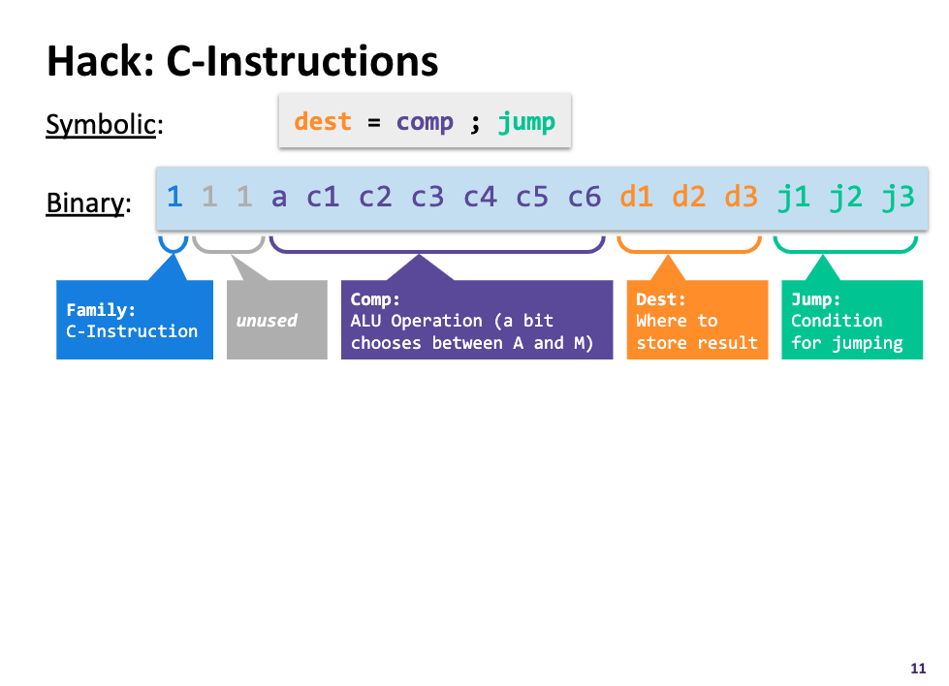
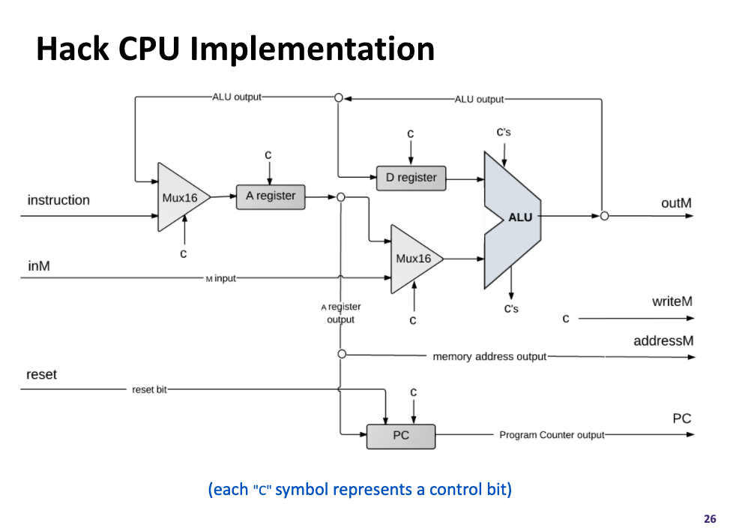
Project 5
Assembly Language
Assembler
Machine Code
Project 6
Computer
Memory
CPU
The connection between software and hardware through binary instructions
What must happen in a clock cycle to process one instruction
ALU
PC
Basic Logic Gates
NAND

Slide 12
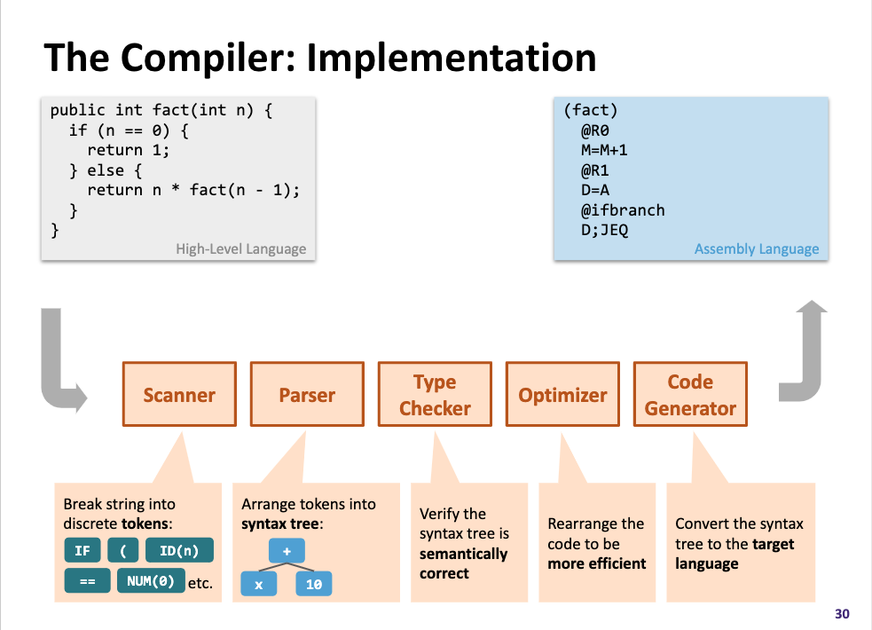
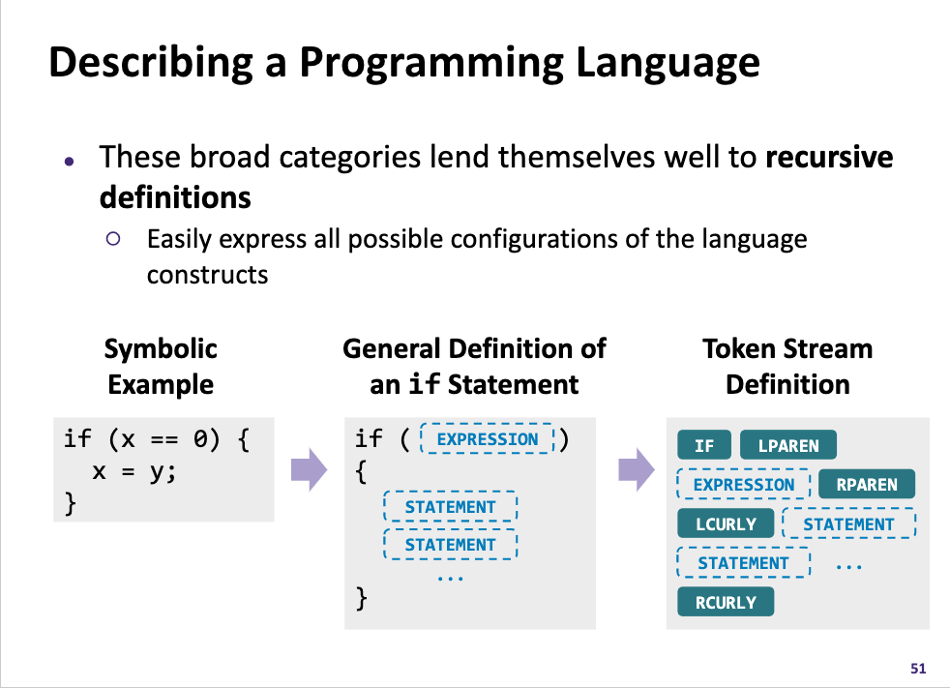
High-Level Language
Project 8
Intermediate Language(s)
Assembly Language
Operating System
Assembler
Machine Code
Computer
Memory
CPU
What happens when you click that compile button?
Programs can read in programs and then spit out equivalent programs
ALU
PC
Basic Logic Gates
NAND

Slide 13
Roadmap
SOFTWARE
HARDWARE
High-Level Language
Intermediate Language(s)
Assembly Language
Operating System
Assembler
Machine Code
Computer
Memory
CPU
ALU
PC
Basic Logic Gates
NAND

Slide 14
SOFTWARE
HARDWARE
331: Software Design
332: Data Structures
421: Algorithms
446: ML … & many more
341: Programming Languages
High-Level Language
Intermediate Language(s)
401: Compilers
333: Systems Programming
Assembly Language
Operating System
451: Operating Systems
452: Distributed Systems
461: Networks
Assembler
351: HW/SW Interface
Machine Code
Computer
Memory
CPU
469: Computer Architecture
ALU
PC
311: Foundations I
Basic Logic Gates
369: Digital Design
NAND
371: Digital Circuits

Slide 15
Takeaways: Why Build a Computer?
A significant engineering effort
  You practiced so many skills and programmed with so many different languages, tools, & paradigms—and you can do it again!
We hope this was a demystifying experience
  To not see CSE courses as isolated but as interconnected puzzle pieces
We hope you had fun in this learning journey!
  The computing field is broad and has much for you to explore
  We are hopeful you found a topic you want to pursue further, both technically and metacognitively

Slide 16
Lecture Outline
E-Portfolio Presentation Guidelines and Tips
CSE 390B Reflection and Victory Lap
  Metacognitive Skills
  Nand2Tetris Projects
CSE 390B TA Panel
  Class Recommendations, Extracurriculars, etc.
CSE 390B Jeopardy Game
  UW History, CSE 390B Course Staff, Seattle, Pop Culture

Slide 17
CSE 390B TA Panel
Ask us about:
Classes
  Recommendations for easy, hard, useful, etc. classes
  What classes go well with each other
Extracurricular activities
  TAing
  Research
  Allen School RSOs
  UW RSOs
Internships

Slide 18
Lecture Outline
E-Portfolio Presentation Guidelines and Tips
CSE 390B Reflection and Victory Lap
  Metacognitive Skills
  Nand2Tetris Projects
CSE 390B TA Panel
  Class Recommendations, Extracurriculars, etc.
CSE 390B Jeopardy Game
  UW History, CSE 390B Course Staff, Seattle, Pop Culture

Slide 19
CSE 390B Jeopardy Game
Organize into teams of 3-4 students
The first group to raise their hand and answer the question wins that round and chooses the next question
The group with the greatest number of points wins the game

Slide 20
Post-Lecture 20 Reminders
Office hours and student-TA 1:1 meetings end this week
  Course staff open to meeting during finals week by appointment
Project Reminders
  Final Project, Part II: Final E-Portfolio due next Tuesday (6/6) at 4pm
  If you have any uncompleted projects, the last day to turn them in is the last day of the quarter (Friday, 6/9 at 11:59pm)
Please fill out course evaluations if you haven’t already

